Slide 1


Trends and climate of US Breweries
A report prepared by Tajar, Inc.
Rajat Chandna, Andy Ho, An Nguyen, Jodi Pafford, and Tori Wheelis

Slide 2
The TAJAR, Inc Team:
Rajat Chandna
Andy Ho
An Nguyen
Jodi Pafford
Tori Wheelis

Slide 3
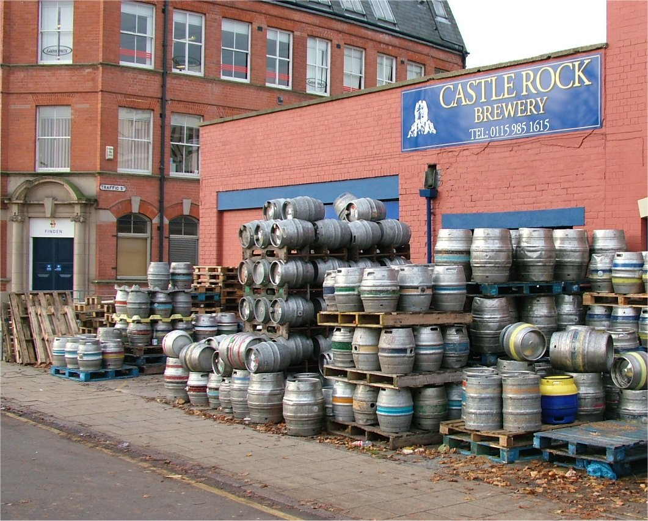
The Brewery File:
Data File with Brewery Information
This Photo by Unknown Author is licensed under CC BY-SA
This Photo by Unknown Author is licensed under CC BY-NC-ND

Slide 4
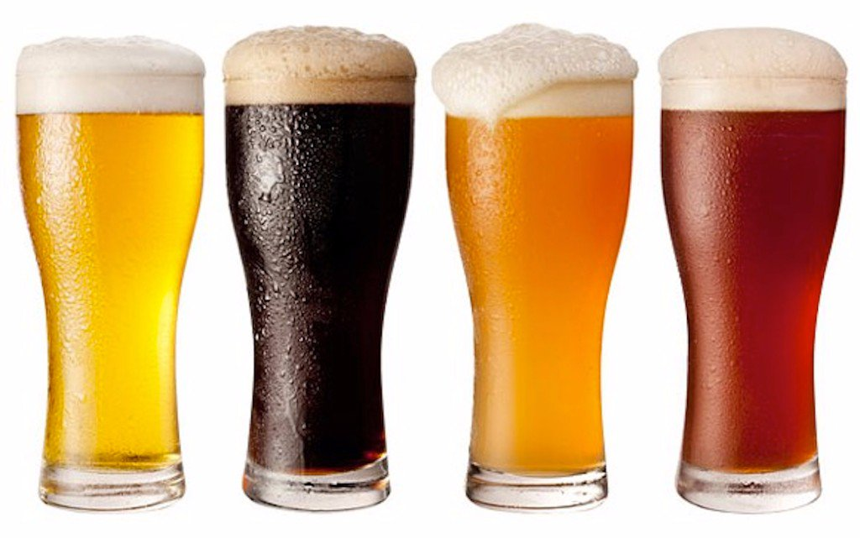
The Beers File:
Data File with Beer Information

Slide 5
Example of Data
Insert Data for Question 2 – Print the first 6 observations and the last 6 observations.

Slide 6
Further Discoveries:
Insert data for question 3 – How many N/As are in each column

Slide 7
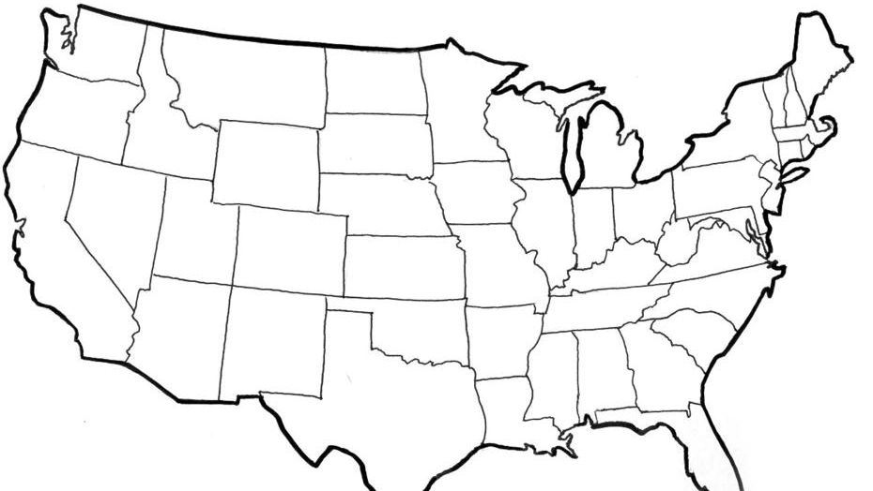
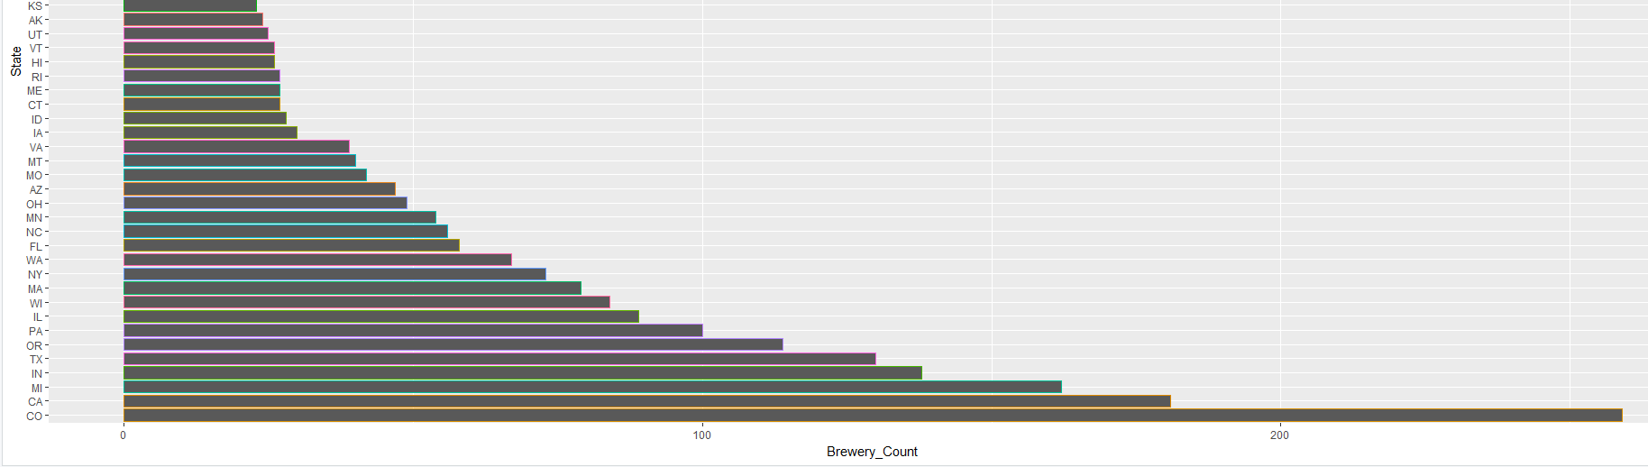
US Brewery Locations
This Photo by Unknown Author is licensed under CC BY-SA

Slide 8
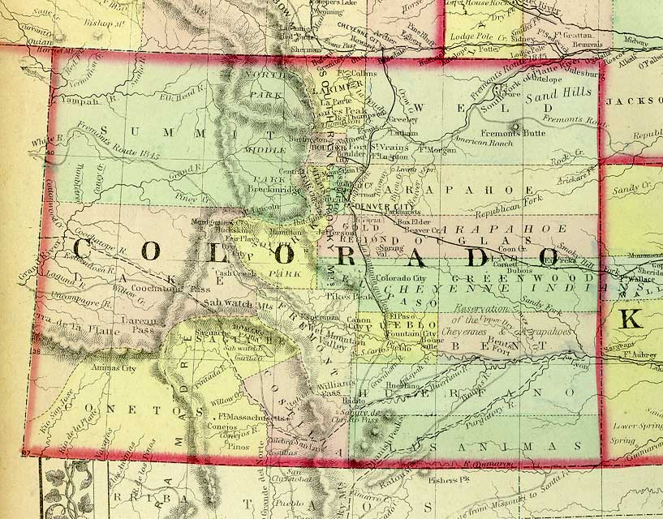
Maximum ABV
12.5% ABV
This Photo by Unknown Author is licensed under CC BY-NC-SA

Slide 9
Other Notable Information about ABV
Bottom 6 Max ABV’s per State
Delaware- 5.5%
Arkansas- 6.1%
Tennessee- 6.2%
New Hampshire- 6.5%
North Dakota- 6.7%
West Virginia- 6.7%
Top 6 Max ABV’s Per State
Colorado- 12.8%
Kentucky- 12.5%
Indiana- 12.0%
New York- 10%
Wisconsin- 9.9%
Texas- 9.9%

Slide 10
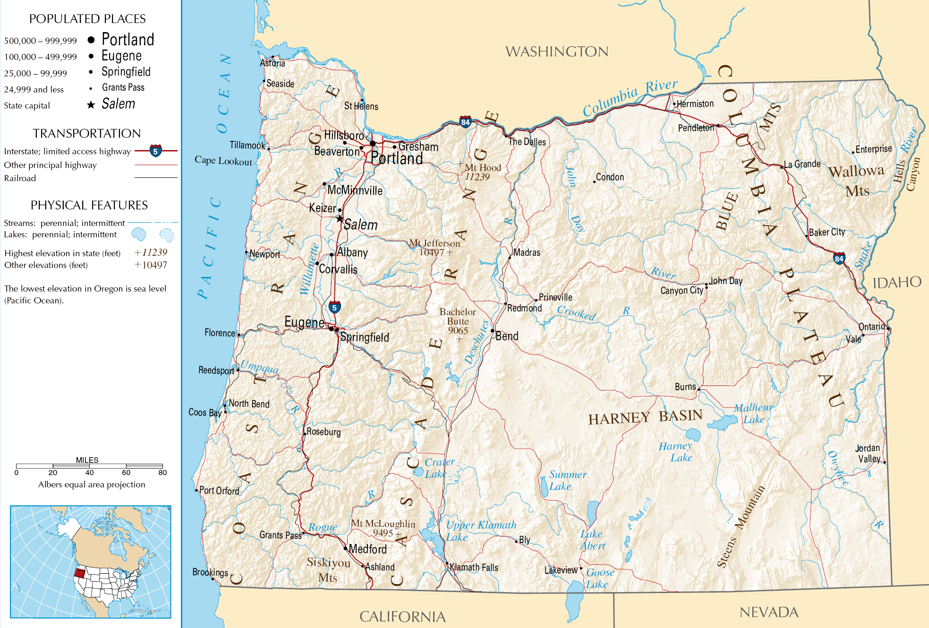
Most Bitter (IBU)
138 IBU
This Photo by Unknown Author is licensed under CC BY-SA

Slide 11
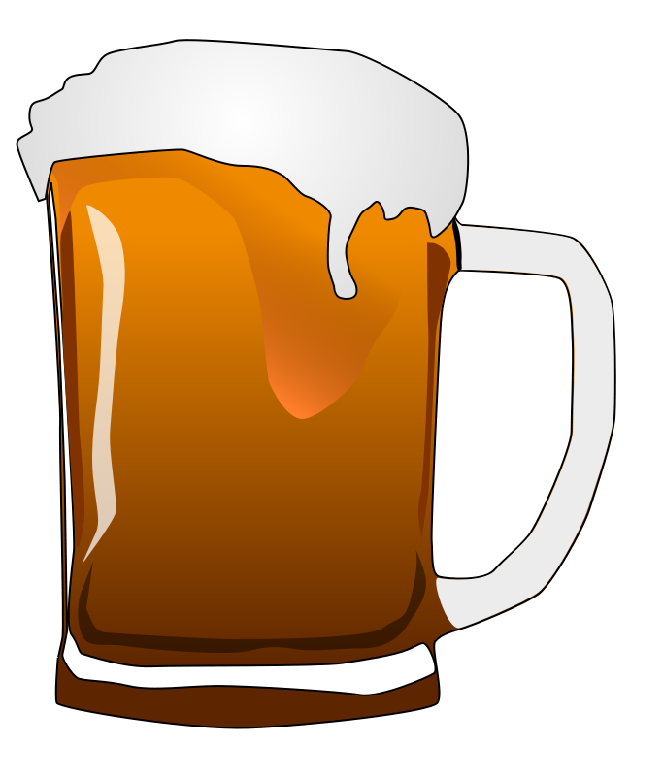
Median Alcohol Content & International Bitterness Units
Top 5 Highest Median IBU’s Per State:
Maine (61)
West Virginia (57.5)
Florida & Georgia (55)
Oregon (54)
Lowest 5 Median IBU’s Per State:
Wisconsin and Kansas (20)
Arizona (20.5)
Wyoming (21)
Hawaii (23)

Slide 12
Median Alcohol Content & International Bitterness Units
Wide range of ABV’s
5.5% (Delaware) to 12.8% (Colorado)
After New York, the next 13 state’s ABV’s are 9.9%
A sizable portion of the beers in the dataset have an ABV at or around 9-10%
The median of the median ABV’s is 9%
The median of the median ABV’s in each state is 9%
The third quartile of the median ABV’s in each state is 9.9%

Slide 13
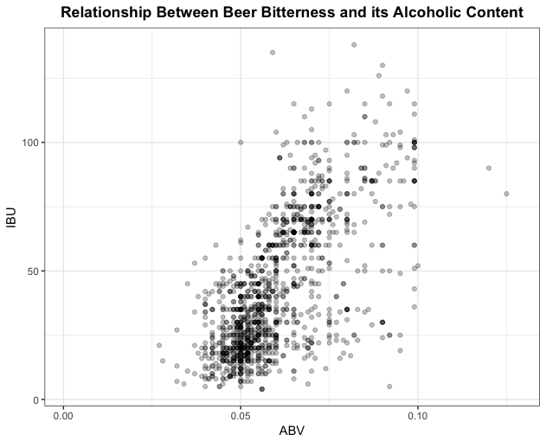
IBU vs ABV Relationship?

Slide 14
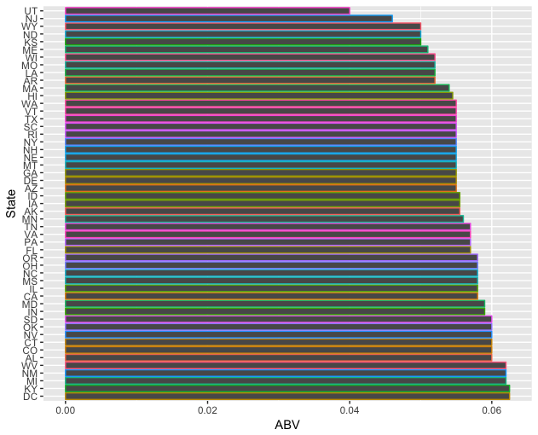
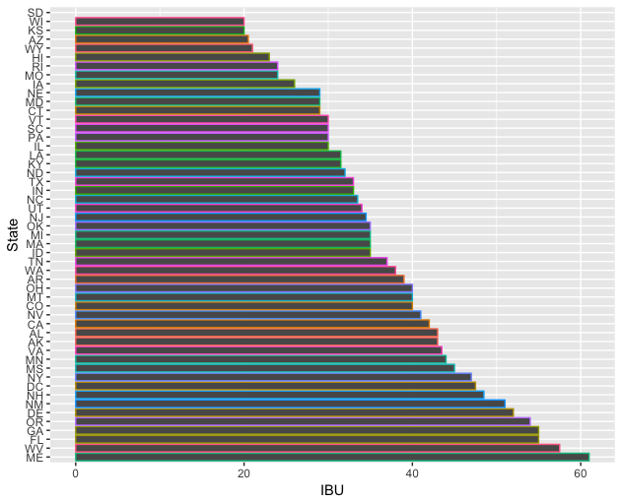
Median IBU and ABV’s per state

Slide 15

Questions?

Slide 16
Thank You for allowing us to partner with you

